Slide 1
YouTube Videos Likeability Predictor
Data Science Programming (ISM 6930)
University of South Florida
Adrian Texeira
Ankit Singh
Tarjani Shah

Slide 2
Motivation
Over the past 5 years YouTube has paid out more than $5 billion to YouTube content creators.
With more and more companies turning to YouTube influencers to capture the millennial audience, getting people to watch your videos on YouTube is becoming increasingly lucrative.
Our goal is to create a model that can help influencers predict the likeability for their next video.

Slide 3
Data Preprocessing
We leveraged Google Developer Console’s YouTube Data API functions.
Using various functions for fetching Video and video related metadata through channels and playlists.
Performed Sentiment Analysis for the comments of the videos and added count of comments as positive, negative and neutral to the existing data as new FEATURES.
Calculated the dependent variable i.e LikePerView and View-Difference using features like LikeCount, ViewCount and PreviousViewCount

Slide 4
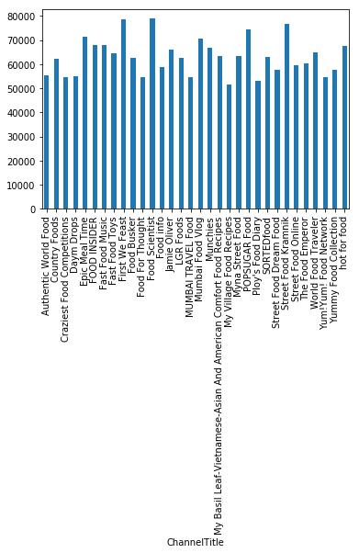
Exploratory Data Analysis

Slide 5
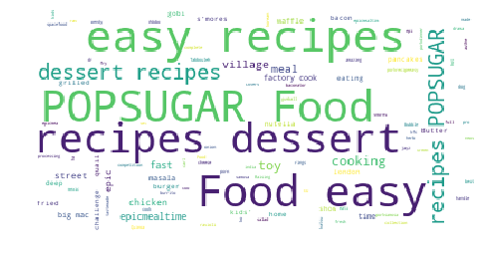
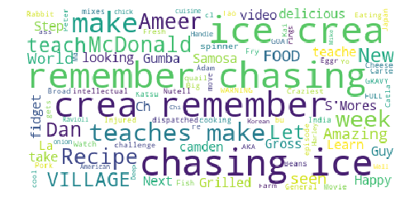

Slide 6
Machine Learning Models
Using models like GradientBoostingRegresor and XGBoostRegressor we were able to predict Likeability of a video based on features like:
Channel View count
Channel subscriber count
Channel age
Previous video views
Video age
Duration

Slide 7
OBSERVATION & RECOMMENDATIONS
Predicting Views was what we started with initially soon to realize it depends on many other factors like content etc.
One of the important observations were that just uploading a video and waiting for days to pass by so that views can increase is a bad idea, one factor which affects views or likeability of a video in general is the CHANNEL.
Another point would be the DURATION of the video, if the video is of a shorter duration and conveys sufficient information it will get views and likes. That’s kind of obvious!

Slide 8
Future Scope
Thumbnails and Title are features that we initially planned to used but couldn't. If running deep learning models can extract hidden features then that might be useful to increase likes.
Another factor contributing to likes of videos would be content, by using models like topic modelling and finding its relevance with respect to the topic can be used as a feature.
This methodology can be extended to different genres of videos.

Slide 9
References
https://towardsdatascience.com/youtube-views-predictor-9ec573090acb
All API calls are referred from this source: https://developers.google.com/youtube/v3/docs/videos
Progress Bar code referenced from: https://github.com/allenwang28/YouTube-Virality-Predictor/blob/master/scripts/get_last_video_count.ipynb
Emoji removal: http://stackoverflow.com/a/13752628/6762004
Code:
https://github.com/allenwang28/YouTube-Virality-Predictor

Slide 10
THANK YOU!!!

